Slide 1


CAR DEKHO
Used Car Price Prediction
Created By :
R. Suresh Kumar

Slide 2


OBJECTIVE
This project aims to enhance customer experience and streamline pricing using machine learning. We will develop an accurate, user-friendly Stream lit tool that predicts used car prices based on input features. This interactive web application will be seamlessly deployed for customers and sales representatives.
PROJECT SCOPE
Buying a used car in the automotive industry can be complex due to various factors affecting pricing. Customers often pay high prices, so we need to develop a machine learning model that accurately predicts used car prices based on input features like model, year, fuel type, and transmission from different cities, among others. This model will be integrated into a Stream lit-based web application, allowing users to enter car details and receive instant price estimates.

Slide 3
APPROACH
Data Cleaning :
1.1 Data convert into DataFrame and add column ‘city’.
1.2 Remove unwanted characteristic, columns, price conversion and change data types.
1.3 Handling missing values on categorical and numerical columns.
1.4 Removing and capping outliers.
2. EDA(Exploratory Data Analysis):
2.1 Descriptive statistic and Plotting.
2.2 Standardization and Encoding for numerical & categorical variable.
2.3 Relationship between categorical variable and target variable & correlation matrix.

Slide 4
3. Feature Selection:
3.1 Lasso for Feature Selection.
3.2 Ridge for Feature Selection.
3.3 Random Forest for Feature Selection.
4. Best Model Identification via Cross Validation:
The following models help identify the best accuracy.
4.1 Linear Regression,
4.2 Decision Tree,
4.3 Random Forest,
4.4 XGB Regressor,
4.5 Model Performance comparison table.

Slide 5
5. Feature engineering and optimization:
5.1 Price conversion.
5.2 Data Preprocessing, Model build with cross validation.
5.3 Optimization using Grid search cv and Model scores.
STREAM LIT APP BUILD
1. User guide.
NOTE : This model is Automatically predicting the price based on user input And output show the ‘price’ and ‘car age’.

Slide 6
1.Data cleaning
1.1 Data convert into Data Frame and add column ‘city’:
In this CAR Dekho dataset is having list of dictionary. To convert these Data Frame for Data cleaning and Manipulating.
Then add city column for each dataset like Chennai, Bangalore etc.. And concat all dataset.
1.2 Remove unwanted characteristic, columns, price conversion and change data types:
These dataset having having duplicate and unwanted columns to remove for improve data quality.
In this dataset ‘price’ column having lakhs, crore and Thousand. These are categories makes error and model complexity so; we need to convert all price into thousand like 1000000,1500000.
To extract the numerical numbers for each columns because columns are containing a lot of missing and inconsistent data so remove that to improve data quality and identify the categorical and numerical columns then change data types.

Slide 7
1.3 Handling missing values on categorical and numerical columns:
In this case I handling missing values on numerical columns first you need to identify the data distribution.
If data is normally distributed is used for mean, data is skewed is best for median.
In this project data is normally distributed so I used for mean.
Then handling missing data for categorical columns, I used for mode. Because mode represents the most frequently occurring category, making it a good estimate to fill in missing values, as it maintains the distribution of the data and helps reduce bias.
1.4 Removing and capping outliers:
Outliers can distort the real patterns in the data, leading the model to learn inaccurate or misleading relationships. So, remove and capping outlier I am using IQR(interquartile range)
Capping is filling outlier Any values below the lower bound with the lower bound value and
Any values above the upper bound with the upper bound value.

Slide 8
2. EDA(Exploratory Data Analysis)
2.1 Descriptive statistic and Plotting:
I used to describe() function is generate summary statistics of a dataset, providing a quick overview of the central tendencies, dispersion, and shape of the distribution like count, min, max, standard deviation etc.. It’s a valuable first step in exploratory data analysis (EDA) because it gives a snapshot of the data, helping to identify any issues, such as outliers, missing values, or potential data entry errors.
2.2 Standardization and Encoding for numerical & categorical variable:
In machine learning model development, scaling and encoding are essential preprocessing steps, especially when dealing with diverse data types and feature ranges.
Many models (e.g., linear regression, SVM, KNN) perform better when features are on similar scales because these models are sensitive to the magnitude of features. Differences in scale can lead to one feature dominating others, affecting the model’s ability to learn effectively.

Slide 9
I am using standard scaling for numerical columns. This standard scaling value converts mean of 0 and standard deviation of 1.
Encoding for nominal and ordinal variables differently is crucial because they represent different types of information and treating them the same way could lead to misleading results in your model.
Nominal variable these categories are not meaningful order or ranking so, that’s why I am using Frequency encoding. Frequency encoding are Identify each unique category in the column.
then Count how often each category appears in that column and Replace each category
with it’s count.
Ordinal variables are meaningful order or ranking so, I am using Ordinal encoding. Ordinal Encoding assigns each category a number according to its order. This encoding preserves the relationship between values, allowing the model to consider that certain levels have higher or lower significance.

Slide 10

2.3 Relationship between categorical variable and target variable & correlation matrix:
Visualize the relationship between Categorical variable and Target variable. This can help you identify which features may have a strong or weak correlation with price, which can guide feature selection, transformation, or even provide insights into how the model might interpret each feature.
Correlation matrix is showing how the features are positive corelated or negative correlated for each variables. This step is identifying the which variables are correlated with price and also the strength of the relationship.

Slide 11
3. Feature selection:
3.1 Feature selection using Lasso:
The main reason for using Lasso for feature selection is that it automatically sets irrelevant feature coefficients to zero, removing them from the model. This simplifies the model, reduces overfitting, and highlights only the most important predictors.
Coefficient represent is relationship between independent variable(features) and dependent variable(target).
3.2 Feature selection using Ridge:
Ridge regression is not primarily used for feature selection, but rather for handling multicollinearity and stabilizing coefficients. Unlike Lasso, Ridge does not shrink coefficients to exactly zero, so it doesn't remove features entirely.
3.3 Feature selection using Random forest:
RFE is used for feature selection because it systematically removes less important features, helping to reduce overfitting, improve model performance, and increase interpretability by keeping only the most relevant features for prediction.

Slide 12
4. Identify best model with Cross validation
In this case I am using Lenier regression, Decision tree, Random forest, XGB regressor.
These all model are used with Cross validation.
4.1 Lenier Regression:
A simple and interpretable algorithm that models the relationship between one or more independent variables (features) and a dependent variable (target) by fitting a straight line (or hyperplane for multiple features).
Strengths:
Simple and interpretable.
Works well for data with a linear relationship.
4.2 Decision tree:
A non-parametric model that splits the data into subsets based on feature values, forming a tree structure. It predicts by traversing the tree to a leaf node with the target value.

Slide 13
Strengths:
Handles non-linear relationships.
Easy to interpret (visualize the tree).
Works well with mixed types of data.
4.3 Random forest:
An ensemble method that builds multiple decision trees (a "forest") and combines their predictions (averaging for regression) to improve accuracy and robustness.
Strengths:
Reduces overfitting compared to a single decision tree.
Handles non-linear relationships well.
Works with large datasets and many features.
Less sensitive to outliers and noisy data.

Slide 14
4.4 XGB Regressor:
An optimized gradient boosting algorithm designed for speed and performance. It builds decision trees sequentially, where each tree corrects the errors of the previous ones.
Strengths:
Highly efficient and fast due to parallel processing.
Handles missing values well.
Can model complex non-linear relationships.
Regularization reduces overfitting.
4.5 Model Performance comparison table:
Finally, XGB Regressor selected based on the model performance.
Name | Test RMSE | CV RMSE | Test R2 Score | CV R2 Score
Lenier regression | 0.8721 | 0.6690 | 0.4118 | 0.4860
Decision Tree | 0.5308 | 0.5256 | 0.7821 | 0.7232
Random Forest | 0.4096 | 0.4045 | 0.8703 | 0.8112
XGB Regressor | 0.4090 | 0.3729 | 0.8707 | 0.8373

Slide 15
5. Feature engineering and optimization
5.1 Price conversion:
Price is converted to Logarithmic form. This transformation enhances both the accuracy and interpretability of predictions.
The price is converted to its logarithmic form to address several issues:
Handle Skewness: Raw price data is often skewed. Log transformation makes the distribution more symmetric, which helps models perform better.
Reduce Variance Issues: It stabilizes the variability of prices across different ranges, improving model reliability.
Focus on Relative Changes: Log transformation emphasizes percentage changes, which align better with real-world scenarios.
Improve Interpretability: In models, coefficients become interpretable as percentage effects on price.

Slide 16
5.2 Data Preprocessing, Model build with cross validation:
A pipeline in machine learning automates the process of preprocessing, feature transformation, and model training/prediction. It ensures consistency, reduces the risk of errors, and makes the workflow modular and reusable. Standard scaling used for convert numerical variable. One hot encoder, Ordinal encoder used for nominal and ordinal variable.
Selecting the features and the target variable is ‘Log price’. I am using selected pipeline with cross validation.
5.3 Optimization using Grid search cv:
Grid Search cv is used to systematically find the best hyperparameters for a model, improve performance, prevent overfitting, ensure robust validation through cross-validation, and automate the tuning process.
Cross-validated RMSE: 0.2062
Cross-validated R-squared: 0.9373
Cross-validated MAE : 0.1305
Test RMSE: 0.2198
Test R-squared: 0.9325
Test MAE : 0.1329
Finally save the best model pickle file.

Slide 17
STREAM LIT APP BUILD
User guide:
This stream lit app predict the car price and car age based on user input.
User inputs:
Body type - type of car (SUV,MUV etc..)
Oem - car brand.
Fuel type - car fuel type (petrol, diesel, cng, electric).
Model - car model.
Transmission - select car transmission (Manual, Automatic)
Engine displacement - engine capacity cc.
Variant name - Select car variant.
Model year - car manufacturing year.

Slide 18
Drive type - front wheel drive or rear wheel drive (FWD, RWD).
Seating capacity - no of seats in the car (5 seat, 7 seat).
km driven - car total running km .
Owner - no of owner in the car.
Mileage - select expected mileage.
City - select city.

Slide 19
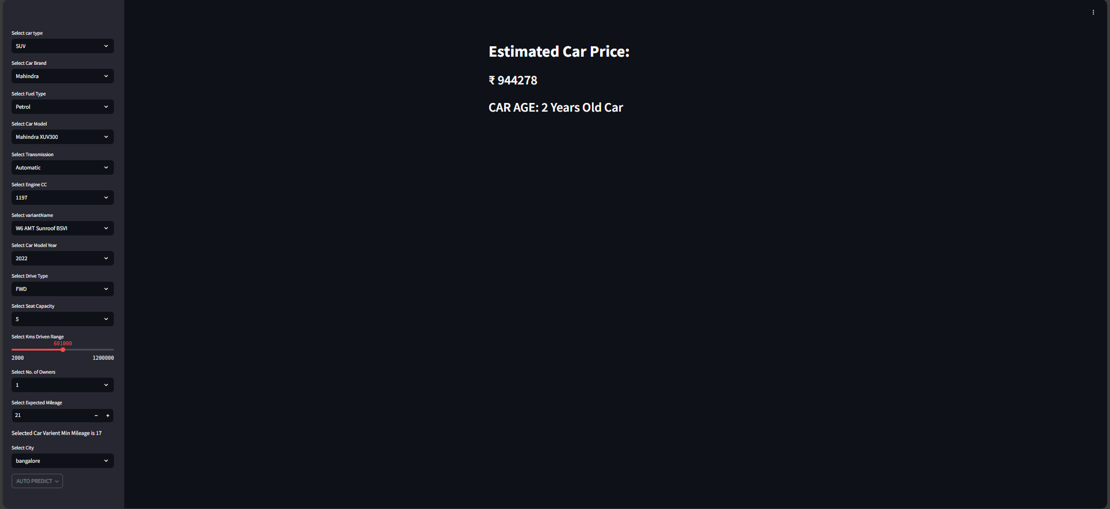
Predicting car price and age
Note : This stream lit app automatically predict
car price and car age based on user input.
User input

